Slide 1

Evaluating Production Bottlenecks Through Downtime Analysis
Presented by Oluwaseun Ifekoya

Slide 2
Key Performance Indicators
645
363
22
Batches Produced
Total production runs
Delayed Batches
Batches experiencing
production delays
Days Lost
Total days lost due to downtime
885
13
4
Downtime Factors
Total instances of
Contributing factors.
Distinctive Downtime Factors
Distinctive instances of
contributing factors.
Max Factors per Batch
Maximum instances of contributing factors per batch.

Slide 3
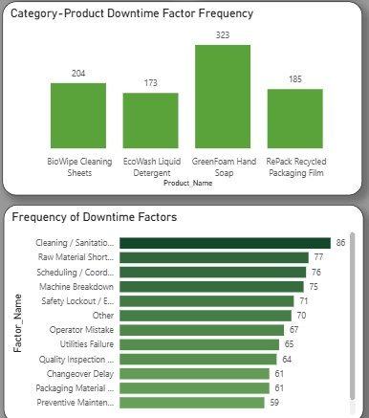
Product Downtime Frequency
GreenTech produces more Eco-cleaning supplies product than Recyclable packaging products, hence the Eco-cleaning supplies category has more downtime frequency.
Among the products, GreenFoam hand soap experienced most downtime during production with factors from Cleaning/Sanitation cycle, Raw material shortage, and Machine Breakdown.

Slide 4
Root Causes of Downtime
Non- Operator Factors
Majorly cleaning/sanitation cycle, raw material shortage and machine breakdown.
Operator Factors
Scheduling/coordination delay and safety lockout/emergency stop are major causes of downtime by operator errors.

Slide 5
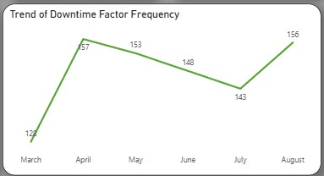
Downtime Trends(March – August 2025)
Most downtimes occurred in April and August, with the least in March.
April experienced a spike due to increase downtime in Greenfoam hand soap and Repack recycled packaging film production.
Downward trend observed from May to July.
Biowipe cleaning sheets had a consistent increase in downtime from April to July.
High downtime recorded in August.
Greenfoam hand soap had a spike in downtime in August.

Slide 6
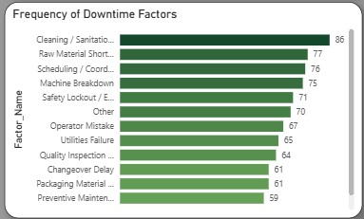
Consistent Downtime Causes
Cleaning/sanitation cycle
Raw material shortage
Scheduling/Coordination delay
Machine breakdown
Safety lockout/emergency stop

Slide 7
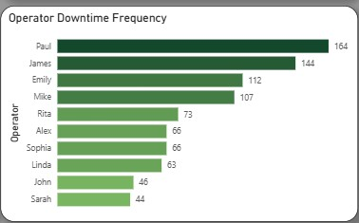
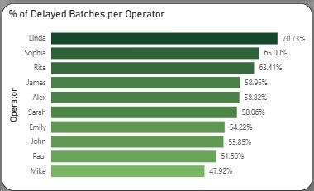
Operator Downtime Analysis
Most Downtimes (Frequency)
Paul
James
Emily
Major Factors: Safety lockout/Emergency stop, Cleaning/Sanitation cycle, Scheduling/Coordination delay, Machine breakdown, and Changeover delay.
Highest Percentage of Delayed Batches
Linda
Sophia
Rita
Major Factors: Scheduling/Coordination delay, Packaging material defect, and Safety lockout/Emergency stop.

Slide 8

Downtime Impact: Time Lost
Frequency of downtime directly correlates with total time spent in downtime.
Primary Causes of Lost Time
Cleaning/sanitation cycle, Raw material shortage, Scheduling/coordination delay.
Operators with Most Time Wasted
Paul, James, and Emily experienced the most time wasted due to downtimes.

Slide 9
Scheduling Gaps Identified
The analysis revealed that some operators were running two or more batches concurrently and this can be a significant cause of downtimes.
The operators include; Paul, James, Emily, and Mike.

Slide 10
Recommendations for improvement
1. Implement Automated Production Scheduling
This will improve batch sequencing, reduce operator overlap, and minimise idle production time.
2. Introduce Predictive and Preventive Maintenance Strategy
Schedule maintenance dynamically based on usage.
3. Inventory Planning
Introduce inventory reorder alerts and forecast material demand based on production history.
4. Optimise Cleaning and Sanitation Process
Schedule cleaning around batch transitions strategically and standardise cleaning procedures.
5. Improve Operator Performance Management and Training
Monitor workload balance across operators and provide training on changeover efficiency.
6. Establish Downtime Severity Escalation Framework
Define downtime severity thresholds and trigger automated alerts for critical downtime events.
7. Introduce Continuous Improvement and Root Cause Review Cycles
Conduct monthly downtime review meetings and prioritise top recurring downtime factors.

